Slide 1
Computer Graphics
Lecture 15,16
Ellipse and Other Curves

Slide 2
Ellipse
An ellipse is a curve that is the locus of all points in the plane, the sum of whose distances r1 and r2 from two fixed points F1 and F2 (the foci) separated by a distance of 2c is a given positive constant 2a. This results in the two-center bipolar coordinate equation:
r1 + r2 = 2a

Slide 3

Ellipse
Minor axis
b
a
Center=(x₀, y₀)
Radius a, b
Center
Major axis
foci
d₁
d₂
d₁+d₂ =2a

Slide 4
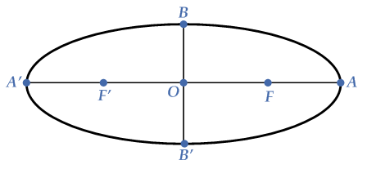
Basics of Ellipse
Minor Axis: The line segment across the ellipse through the center and perpendicular to the major axis is called the minor axis of the ellipse. In the given diagram BB′ is the minor axis of the ellipse.
Vertices: The endpoints of the major axis are called the vertices of the ellipse. In the given diagram A and A′ are the vertices of the ellipse.
Co-Vertices: The endpoints of the minor axis are called the co-vertices of the ellipse. In the given diagram B and B′ are the co-vertices of the ellipse.
It is noted that the ellipse meets its major axis at the vertices. In the given diagram the foci of the ellipse are F and F′, the vertices are A and A′ its center is O.

Slide 5
Midpoint Ellipse Algorithm
To apply the midpoint method, we define an ellipse function:
p_{ellipse} (x, y) = r_{y}²x² + r_{x}²y² – r_{x}² r_{y}²
m<1
x_{k+1} = x_{k} + 1 (unit interval)
y_{k+1} = y_{k} or (y_{k} – 1)
m<1
Q₁
Q₁
m=1
Q₂
m>1
m>1
y_{k+1} = y_{k} + 1 (unit interval)
x_{k+1} = x_{k} or (x_{k} + 1)
Q₂

Slide 6
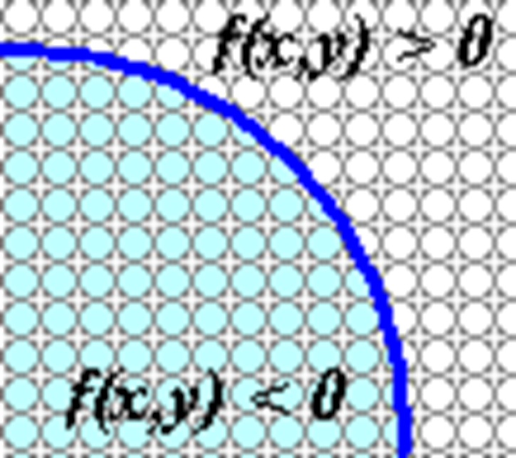
Ellipse
The following relations can be observed:
f _{ellipse} (x, y) < 0, if (x, y) is inside the ellipse boundary
f _{ellipse} (x, y) = 0, if (x, y) is on the ellipse boundary
f _{ellipse} (x, y) > 0, if (x, y) is outside the ellipse boundary

Slide 7
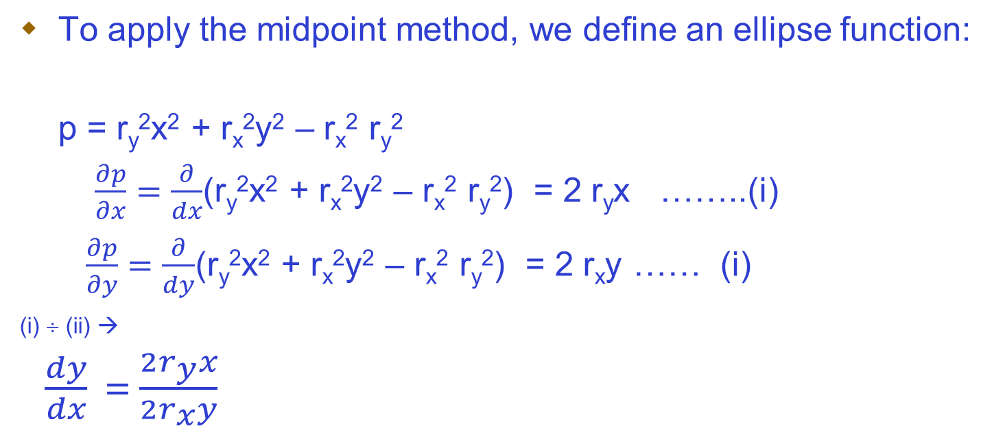

Ellipse

Slide 8
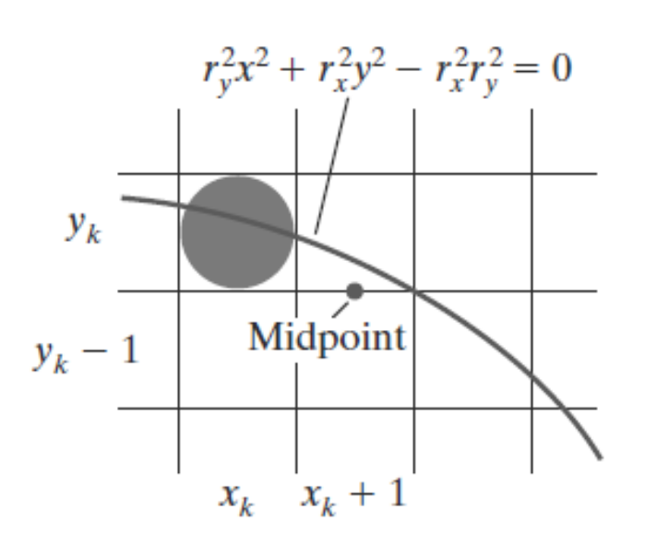
Region-1
m<1
Current pixel=(x_{k} ,y_{k})
Next pixel=(x_{k+1} ,y_{k-1})
=(x_{k} + 1, y_{k})
Midpoint pixel=(x_{k}+1 ,y_{k} – ½)
y_{k+1} = y_{k} - 1 or y_{k}
x_{k+1} = x_{k} + 1 (unit interval)
P1_{k} = f_{ellipse} ( x_{k} + 1, y_{k} – ½ )
= r²_{y} ( x_{k} + 1)² + r_{x}² ( y_{k} – ½ )² – r_{x}² r_{y}²
At starting point
P1_{k} = f_{ellipse} ( 0, r_{y})
= r²_{y} ( 0 + 1)² + r_{x}² ( r_{y} – ½ )² – r_{x}² r_{y}²
= r²_{y} + r_{x}² ( r_{y}² – r_{y} + 1/4 )– r_{x}² r_{y}²
= r²_{y} – r_{x}² r_{y} + r_{x}² /4
i) if p>=0 ➔ (x_{k} +1, y_{k} - 1)
ii) if p<0 ➔ (x_{k+}+ 1, y_{k} )
P1_{k+1} = f_{ellipse} ( x_{k +1}+ 1, y_{k+1} – ½ )
= r_{y}² [( x_{k} + 1)+1]² + r_{x}² (y_{k+1} – ½) ² – r_{x}² r_{y}²
P1_{k+1} = P1_{k} + 2r_{y}²(x_{k}+1) + r_{x}²(y_{k+1}²–y_{k}²) – r_{x}² (y_{k+1} - y_{k} ) + r_{y}²
  When P1_{k}>=0 then P1_{k+1}= P1_{k} + 2 r_{y}² ( x_{k} + 1) – 2 r_{x}² ( y_{k}– 1 ) + r²_{y}
  When P1_{k}< 0 then P1_{k+1}= P1_{k} + 2r_{y}²(x_{k}+1) + r_{y}²

Slide 9
Region-2
Let m>1
Current pixel=(x_{k} ,y_{k})
Next pixel=(x_{k} ,y_{k}- 1)
=(x_{k+1} ,y_{k}-1)
Midpoint pixel=(x_{k}+½ ,y_{k} – 1)
y_{k+1} = y_{k} + 1 (unit interval)
x_{k+1} = x_{k} or (x_{k} + 1)
At starting point (last pixel of region 1)
P2_{k} = f_{ellipse} (x_{k} ,y_{k} )
= r²_{y} ( x_{k} + ½)² + r_{x}² ( y_{k} – 1 )² – r_{x}² r_{y}²
i) if p>=0 ➔ (x_{k} , y_{k} - 1)
ii) if p<0 ➔ (x_{k+}+ 1, y_{k} - 1)
P2_{k+1} = f_{ellipse} ( x_{k +1}+ ½, y_{k+1} – 1 )
= r_{y}² ( x_{k+1} + ½)² + r_{x}² (y_{k} – 1 – 1) ² – r_{x}² r_{y}²
P2_{k+1} = P2_{k}– 2r_{x}²(y_{k} –1) + 2r_{y}²(x²_{k+1} – x²_{k}) + r_{y}²(x_{k+1}–x_{k}) + r_{x}²
  When P2_{k}>=0 then P2_{k+1}= P2_{k}– 2r_{x}²(y_{k} –1) + r_{x}²
  When P2_{k}<0 then P2_{k+1}= P2_{k}+ 2r_{y}²(x_{k} +1) - 2r_{x}²y_{k}+ 3r_{x}²

Slide 10
Example
r_{x} = 8 and r_{y} = 6
Region Q1
P10 = r²_{y} – r_{x}² r_{y} + r_{x}² /4
k | (x_{k},y_{k}) | P1_{k} | (x_{k+1},y_{k+1}) | 2x_{k+1}r_{y}² | 2y_{k+1}r_{x}²
0 | (0,6) | -332 | (1,6) | 72 | 768
1 | (1,6) | -224 | (2,6) | 144 | 768
2 | (2,6) | -44 | (3,6) | 216 | 748
3 | (3,6) | 208 | (4,5) | 288 | 640
4 | (4,5) | -108 | (5,5) | 360 | 640
5 | (5,5) | 288 | (6,4) | 432 | 512
6 | (6,4) | 244 | (7,3) | 504 > | 384
7
m<1
Current pixel=(x_{k} ,y_{k})
Next pixel
i) if p>=0 ➔ (x_{k} +1, y_{k} - 1)
ii) if p<0 ➔ (x_{k+}+ 1, y_{k} )

Slide 11
Example
r_{x} = 8 and r_{y} = 6
Region Q2
P2_{k+1} = P2_{k}– 2r_{x}²(y_{k} –1) + 2r_{y}²(x²_{k+1} – x²_{k}) + r_{y}²(x_{k+1}–x_{k}) + r_{x}²
P2_{k} = r²_{y} ( x_{k} + ½)² + r_{x}² ( y_{k} – 1 )² – r_{x}² r_{y}²
m>1
Start Point of Q2= (7, 3)
P2_{k}=f_{circle}(7+1/2 , 3-1) = -23
Current pixel=(x_{k} ,y_{k})
Next pixel
i) if p>=0 ➔ (x_{k} , y_{k} - 1)
ii) if p<0 ➔ (x_{k+}+ 1, y_{k} - 1)
k | (x_{k},y_{k}) | P1_{k} | (x_{k+1},y_{k+1}) | 2x_{k+1}r_{y}² | 2y_{k+1}r_{x}²
0 | (0,6) | -332 | (1,6) | 72 | 768
1 | (1,6) | -224 | (2,6) | 144 | 768
2 | (2,6) | -44 | (3,6) | 216 | 748
3 | (3,6) | 208 | (4,5) | 288 | 640
4 | (4,5) | -108 | (5,5) | 360 | 640
5 | (5,5) | 288 | (6,4) | 432 | 512
6 | (6,4) | 244 | (7,3) | 504 > | 384
7 | (7,3) | -23 | (8,2) | 576 | 256
8 | (8,2) | 361 | (8,1) | 576 | 128
9 | (8,1) | 297 | (8,0) | 576 | 0
Region Q1
Region Q2

Slide 12
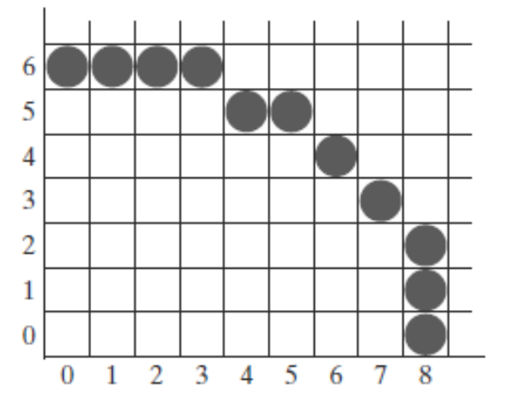
Example
r_{x} = 8 and r_{y} = 6
k | (x_{k},y_{k}) | P1_{k} | (x_{k+1},y_{k+1}) | 2x_{k+1}r_{y}² | 2y_{k+1}r_{x}²
0 | (0,6) | -332 | (1,6) | 72 | 768
1 | (1,6) | -224 | (2,6) | 144 | 768
2 | (2,6) | -44 | (3,6) | 216 | 748
3 | (3,6) | 208 | (4,5) | 288 | 640
4 | (4,5) | -108 | (5,5) | 360 | 640
5 | (5,5) | 288 | (6,4) | 432 | 512
6 | (6,4) | 244 | (7,3) | 504 > | 384
7 | (7,3) | -23 | (8,2) | 576 | 256
8 | (8,2) | 361 | (8,1) | 576 | 128
9 | (8,1) | 297 | (8,0) | 576 | 0
Region Q1
Region Q2

